Slide 1
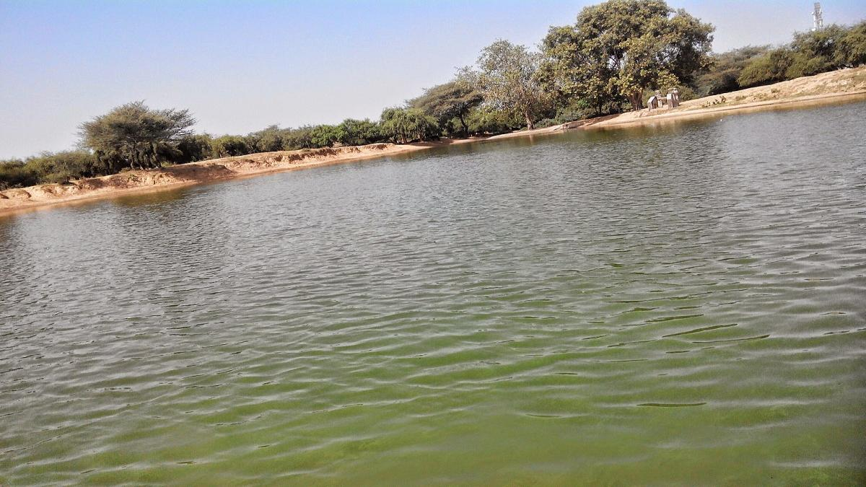
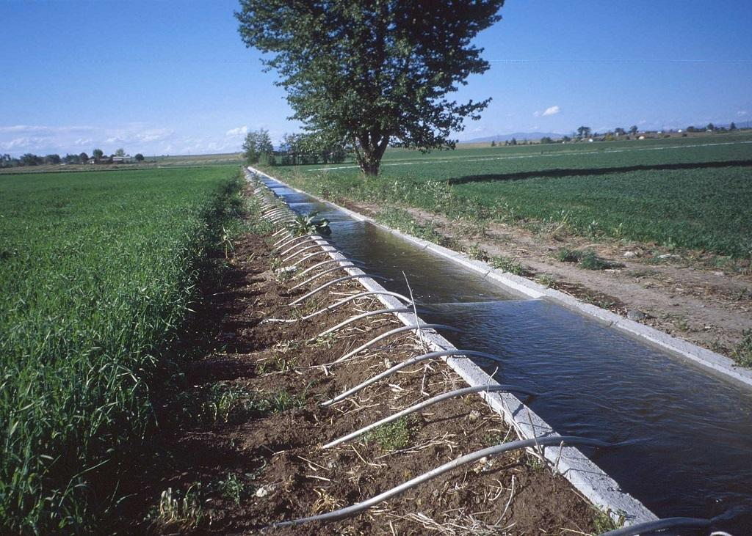

Presented BY:
Maham Kausar
3 rd SEM,M TECH IN URP

Slide 2
Introduction
India Water Portal was encouraged by the National Knowledge Commission, which proposed the need for knowledge portals in various areas in 2005
Since then, it has evolved to become one of the foremost sources of information in India for water, sanitation, agriculture, the environment, climate change, biodiversity, and other related thematic areas.
India Water Portal is a web-based platform that provides comprehensive information, resources, and tools related to water management and conservation in India.
The India Water Portal aims to promote awareness, facilitate knowledge sharing, and foster collaboration among stakeholders to address the water challenges faced by the country.

Slide 3
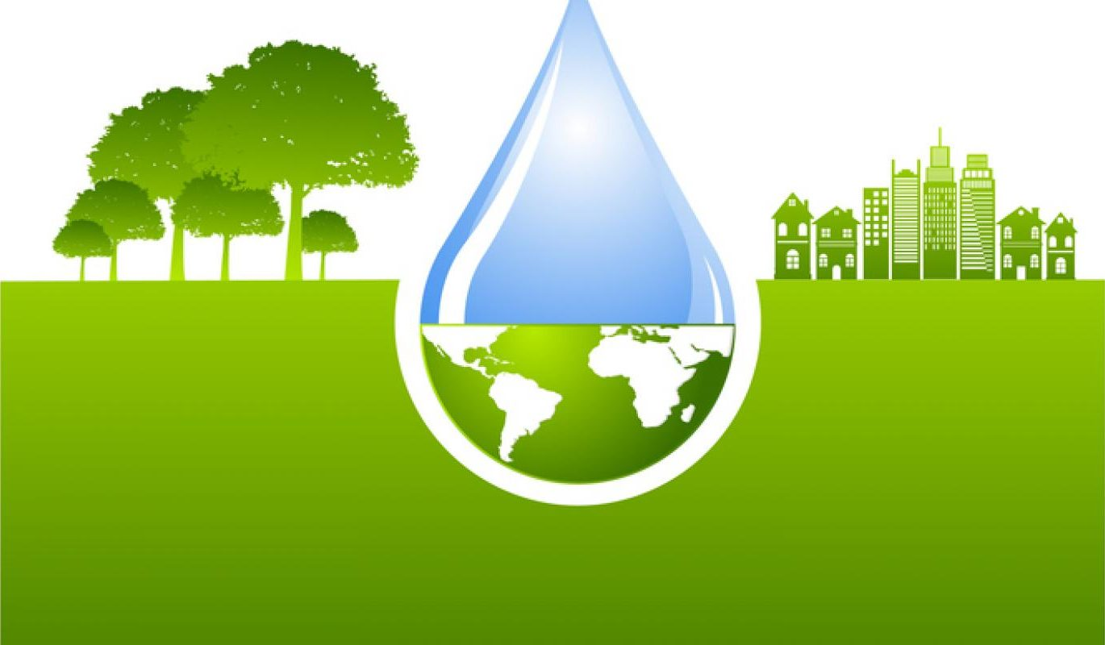

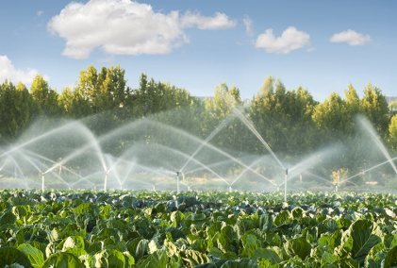
Objectives
To serve as a comprehensive online platform for sharing knowledge, information, and resources related to water management in India.
Providing reliable information on water resources, usage, and management in India.
Raising awareness about water-related issues and promoting sustainable practices.
Facilitating knowledge sharing and collaboration among stakeholders.

Slide 4

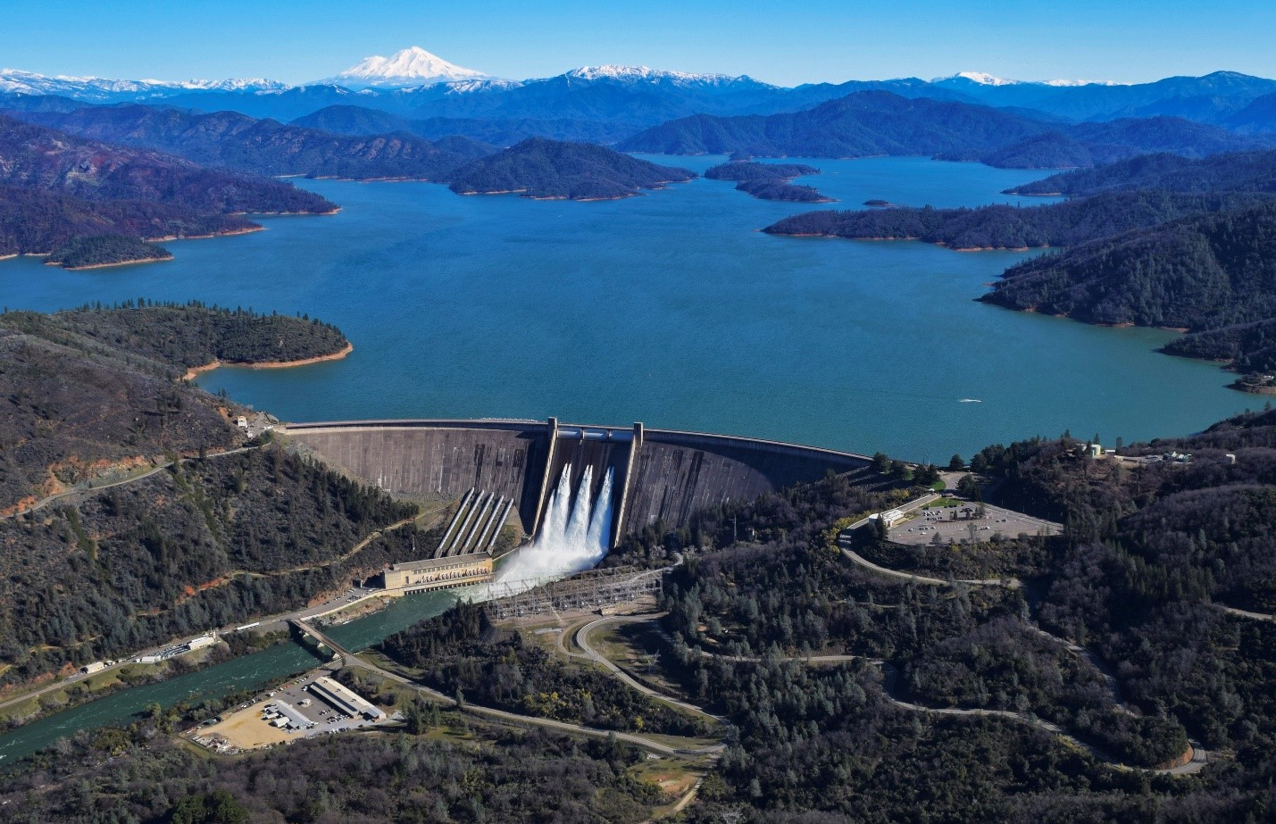
Features of India Water Portal
Information and Articles: The portal offers a wide range of articles, research papers, case studies, and news updates on various aspects of water management, including water conservation, water quality, irrigation, groundwater, and policy developments.
Data and Maps: It provides access to a comprehensive collection of water-related data, including hydrological data, rainfall patterns, groundwater levels, river basin profiles, and water resource maps. These resources aid in understanding the current water situation in different regions of India.
Tools and Applications: These assist users in water-related analysis and decision-making. These include groundwater assessment tools, rainfall calculators, water footprint calculators, and irrigation water requirement calculators.

Slide 5
Features of India Water Portal
Discussion Forums: India Water Portal facilitates discussion forums here users can engage in discussions, ask questions, and share knowledge and experiences related to water management.
Resource Library: The portal maintains a resource library comprising reports, publications, manuals, guidelines, and educational materials related to water management. Users can access and download these resources for further reference.
Events and Training Programs: It highlights upcoming events, conferences, workshops, and training programs related to water management in India. This feature enables users to stay updated on relevant opportunities for capacity building and networking.

Slide 6
Types of Data Available
Water quality data: Information about water quality parameters such as pH, dissolved oxygen, turbidity, and presence of contaminants in various water bodies across India.
Groundwater data: Data related to groundwater levels, groundwater quality, and trends in groundwater availability in different regions of India.
River basin data: Details about major river basins, including water flow, water storage, and hydrological data.
Rainfall data: Rainfall patterns, precipitation levels, and meteorological data across different regions of India.
Water management data: Information about water management practices, policies, and initiatives implemented by various government bodies and organizations.
Water-related projects: Details about ongoing and completed water-related projects, including irrigation schemes, dam construction, water supply projects, and water conservation initiatives.
Research and reports: Access to research studies, reports, and publications related to water resources, water management, and sustainable water practices in India

Slide 7
Conclusion
India Water Portal provides a comprehensive and user-friendly interface that facilitates information sharing, data analysis, and collaboration among various stakeholders.
By promoting transparency, efficiency, and sustainable practices, the portal contributes to the conservation and equitable distribution of water resources across the country.

Slide 8



Slide 9
Introduction
The India Environment Portal is initiated and managed by the Centre for Science and Environment (CSE) promoted by the National Knowledge Commission (NKC), Government of India.
The India Environment Portal provides open access to information about environmental and developmental issues in India.
Provides data from research institutions, government bodies, NGOs, universities, the mass media, and experts across various issues of environmental management.

Slide 10
Objectives
Promoting Sustainable Development: Encouraging sustainable practices and environmental conservation by showcasing successful projects, initiatives, and technologies that support eco-friendly development.
Fostering Community Engagement: Encouraging public participation and awareness about environmental issues through educational resources, news, and updates on environmental events and campaigns.
Disseminating Environmental Information: To Provide access to reliable and accurate environmental data, news, and research findings to stakeholders, including policymakers, researchers, and the general public.

Slide 11
Features of Environmental Portal
Extensive Database: The portal boasts a massive collection of over 4,00,000 research reports, government documents, and other relevant materials.
Search and Filter: Users can search for specific topics and filter results to find relevant information.
News and Updates: The portal provides latest news, reports, and documents on various environmental topics, including climate change, air and water pollution, and wildlife conservation.
Open-Source Platform: The portal is built on an open-source platform, ensuring that information is widely accessible and freely shared among users.
Collaboration and Networking: The portal aims to facilitate dynamic interaction and networking among users, institutions, and researchers working on environmental issues.

Slide 12
Types of Data Available
Population Data: The portal provides access to population data sheets,population size, structure, and growth rates, as well as fertility, mortality, and migration.
E-Waste Data: You can also find reports on electronic waste, like the Global E-waste Monitor 2024, which provides insights into the world's electronic waste generation and recycling rates.
Biodiversity and Wildlife Data: The portal offers information on India's biodiversity, including data on wildlife species.
Environmental Statistics and Infographics: The portal provides statistics and infographics on various environmental topics, including climate change, air and water pollution, and waste management.

Slide 13
Conclusion
The India Environment Portal is a vital platform that serves as a comprehensive resource for environmental information, education, and awareness in India.
By providing access to a vast array of data, research, and initiatives, the portal plays a crucial role in promoting environmental sustainability and conservation.

Slide 14

THANK YOU

